Slide 1
CS1010X Lecture 7:
Data Abstraction
Notes:
Lecture 7a video

Slide 2
Quick Review
Lecture 1: get to know Python
Lecture 2: solve with a single function / abstraction
Lecture 3: solving with many functions…
Lecture 4: solving with recursion/iteration
Lecture 5: Debugging
Lecture 6: Higher Order Function
(Function Abstraction)
Lecture 7: Data Abstraction
- beyond number, string…tuple (L7, 8), list (L9, 10), dictionary
- An example ADT…Rational number package
- Equality… == vs is
- Working with files… (text file, csv file)

Slide 3
Recap: Function Abstraction
  Abstracts away irrelevant details, exposes what is necessary
  Separates usage from implementation
  Captures common programming patterns
Serves as a building block for more complex functions

Slide 4
Recap: Function Abstraction
Data
  Abstracts away irrelevant details, exposes what is necessary
  Separates usage from implementation
  Captures common programming patterns
Serves as a building block for more complex functions
data
ADT: Abstract Data Type
We can organize and reason about data
in the same way like function !!
Once we master the function/data abstraction,
we can build interesting/large applications

Slide 5
What is programming…
Dealing with interaction / relation of properties / attributes of objects
  In picture language: pictures (e.g. rcross_bb)
  In GCD: 2 numbers, and to find another number
  In taxi-fare: for the “object” distance, find the “property” or “attribute” called fare.
  …

Slide 6
Modeling object beyond number, string….
Real object of a student:
  number…e.g. NRIC
  string…e.g. Name
  “many strings”…. e.g. courses taken/taking
  …
System provides sequences such as:
tuple (L7, L8), list (L9, L10), dictionary, …
When we don’t have enough primitive in picture language,
we ask for more support from the system…
e.g. stack_frac(frac, pic1, pic2 )

Slide 7
Tuple
… glue data together…

Slide 8
Tuples - Basic
>>> x = (1, 'ab')
>>> x
(1, 'ab')
>>> x[0]
1
>>> x[1]
'ab'
>>> y = (3, 4)
>>> z = (x, y) # A tuple of tuples
>>> z[0]
(1, 'ab')
>>> z[1]
(3, 4)
>>> z[1][1]
4

Slide 9
Box-and-pointer notation
A way to visualize tuples
x = (1,'ab') is drawn:
Variable x points to tuple
  Left arrow is [0]
  Right arrow is [1]
x
1
'ab'

Slide 10
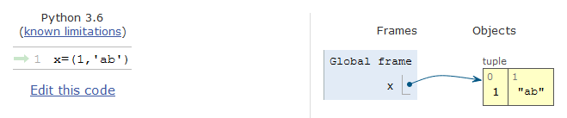
Box-and-pointer notation
A way to visualize tuples
x = (1,'ab')is drawn:
contents are outside the tuple, not inside
x
1
'ab'
OR
x
Python Tutor
1
'ab'

Slide 11
Box-and-pointer notation
4
>>> x = (2, 7)
>>> y = (x, 5)
>>> y
((2, 7), 5)
>>> y[0][0]
2
>>> y[0][1]
7
>>> x = (1, 4)
>>> y
((2, 7), 5)
1
tuple is
immutable
x
7
2
y
5

Slide 12
Tuple behaves like …
String
>>> bar = (1, 2)
>>> bat = (3, 4)
>>> foo = bar + bat
>>> foo
(1, 2, 3, 4)
>>> e = ()
>>> e
()
>>> foo2 = (bar, bat)
>>> foo2
((1, 2), (3, 4))
>>> (foo2)
((1, 2), (3, 4))
>>> (foo2,)
(((1, 2), (3, 4)),)
>>> bar = '12'
>>> bat = '34'
>>> foo = bar + bat
>>> foo
'1234'
>>> e = ''
>>> e
''
>>> foo2 = (bar, bat)
>>> foo2
('12', '34')
>>> (foo2)
('12', '34')
>>> (foo2,)
(('12', '34'),)

Slide 13
Recap: Slicing
s[start:stop:step]
Slicing returns a new string
>>> s = 'abcdef'
>>> s[0:2]
'ab'
>>> s[:2]
'ab'
>>> s[1:5:3]
'be'
>>> s[-1::-2]
'fdb'
>>> len(s[-1::-2])
3
>>> for i in s[-1::-2]:
print(i)
f
d
b
>>> s = ('a','b','c','d','e','f')
>>> s[0:2]
('a', 'b')
>>> s[:2]
('a', 'b')
>>> s[1:5:3]
('b', 'e')
>>> s[-1::-2]
('f', 'd', 'b')
>>> len(s[-1::-2])
3
>>> for i in s[-1::-2]:
print(i)
f
d
b

Slide 14
Abstract Data Type
(compound data)
Notes:
Lecture 7b video

Slide 15
Guidelines for Creating Compound Data
Constructors
  Means to create compound data from primitive data or other.
Selectors (accessors) and mutators
  Means to access/modify individual component of compound data.
Predicates (true / false)
  Means to ask about compound data. Eg. ==, and is
Printers
  Means to display compound data in human-readable form.
(Arithmetic) Operations
  Means to operate with the data (without knowing their internal representations)

Slide 16
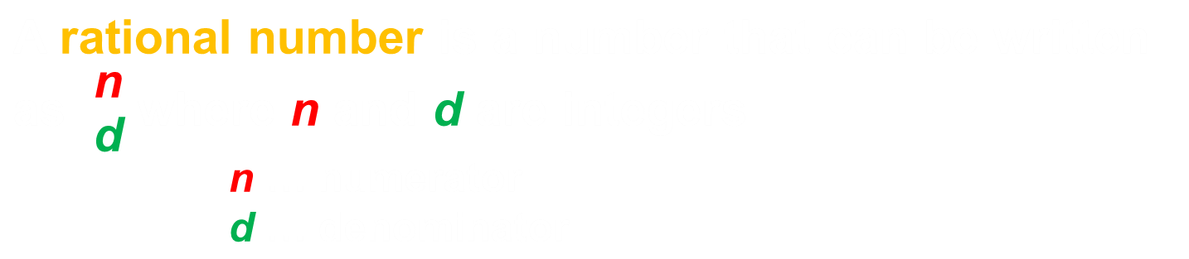

E.g. Rational Number
So, nature to use just a tuple with 2 elements to represent it.

Slide 17
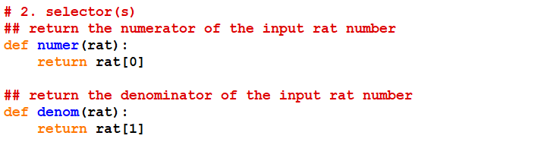
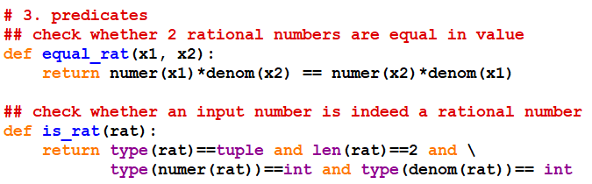
E.g. Rational Number

Slide 18
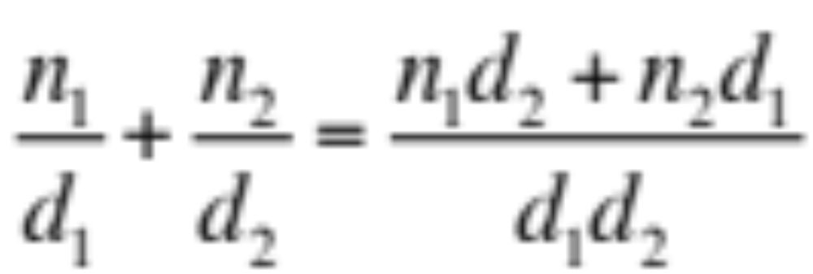

Arithmetic Operations
Addition:

Slide 19

Arithmetic Operations
Subtraction:

Slide 20
Arithmetic Operations
Multiplication:

Slide 21
Arithmetic Operations
Division:

Slide 22
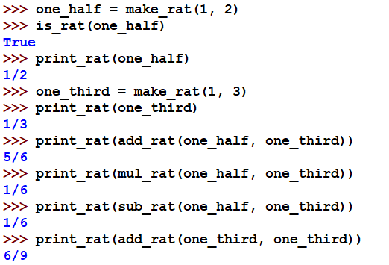
Working with Rational Number
Ouch! Prefer: 2/3

Slide 23
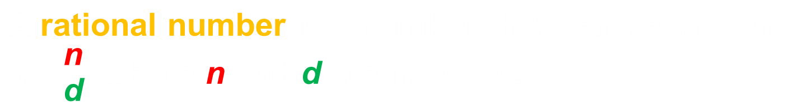

E.g. Rational Number
Implementing rat #1*

Slide 24
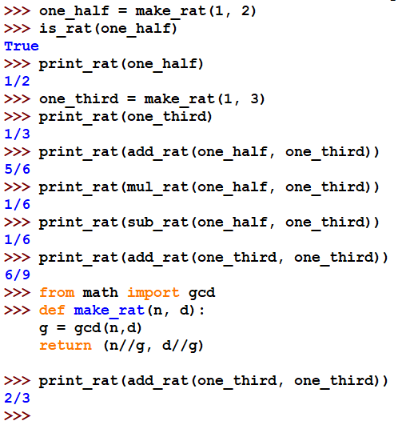
Working with Rational Number

Slide 25
Abstraction Barrier
Programs that use rational numbers
Rational numbers in the problem domain
equal_rat add_rat sub_rat … print_rat
Rational numbers as numerators and denominators
make_rat numer denom is_rat
Rational numbers as tuples
tuple
Tuples are implemented in system

Slide 26
Abstraction Barrier
Programs that use rational numbers
Rational numbers in the problem domain
equal_rat add_rat sub_rat … print_rat
Rational numbers as numerators and denominators
make_rat numer denom is_rat
Rational numbers as tuples
tuple
Tuples are implemented in system

Slide 27
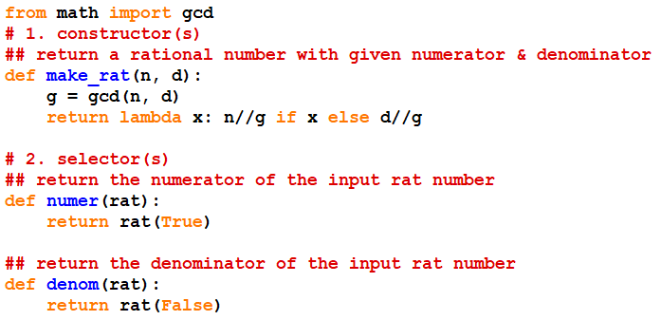
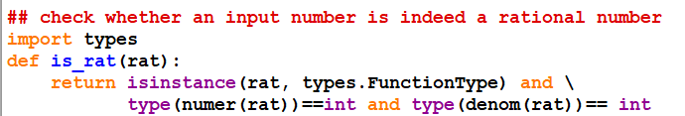
Implementing rats #2
Use lambda to “represent” numerator and denominator

Slide 28
Implementing rats #2
Use lambda to “represent” numerator and denominator

Slide 29
Implementing rats #2
Use lambda to “represent” numerator and denominator

Slide 30
Abstraction Barrier
Programs that use rational numbers
Rational numbers in the problem domain
equal_rat add_rat sub_rat … print_rat
Rational numbers as numerators and denominators
make_rat numer denom is_rat
functions
Rational numbers as tuples
function
tuple
Tuples are implemented in system
Note: Python is not the right language that can protect barrier.

Slide 31
Exercise
Implement a new Abstract Data Type (ADT)
set with the following associated functions:
  make_set()
  – creates a new empty set object
  add_set(set,object)
  – adds an object to a set
  remove_set(set,object)
  – removes an object
  contains_set(set,object)
  – returns True if the set contains the object
Note: Python has a built-in set
Notes:
Not in video

Slide 32
Equality

Slide 33
Two possibilities of equality
1. Equivalence
  This means two objects that have the same content (even if they are not the same object)
  In Python, we use == to test for this.
2. Identity
  This means the SAME object (reference in memory even if they have different variable names)
  In Python, we use is to test for this.
Identity ➔ Equivalence

Slide 34
Equality
is returns True if the two objects are the same object
== returns True if the two objects are equivalent
>>> a, b = 1, 2
>>> x = (a, b)
>>> y = (a, b)
>>> x is y
False
>>> x == y
True
>>> z = x
>>> z is x
True
>>> z is y
False
>>> z == y
True
x
2
z
1
y
2
1

Slide 35
Equality
>>> ('apple', 1, 2, 3) == ('apple', 1, 2, 3)
True
>>> ('apple', 1, 2, 3) is ('apple', 1, 2, 3)
True
>>> ('apple', 1, 2, 3) == ('apple', (1, 2), 3)
False
>>> a = ('apple', 1, 2, 3)
>>> a == ('apple', 1, 2, 3)
True
>>> a is ('apple', 1, 2, 3)
False
>>> a == ('apple', 1, (2), 3)
True
>>> a == ('apple', 1, (2,), 3)
False

Slide 36
Caution with is
is cannot be used to compare numbers reliably.
>>> 3 is 3
True
>>> 3.000 is 3
False

Slide 37
Summary
Compound data helps us to reason at a higher conceptual level. You can built: complex number, set, etc.
We can choose between different implementations as long as contract / interface is fulfilled.
Abstraction barriers separate usage of a compound data from its implementation.
  Only functions at the interface should be used.

Slide 38
Working with files
Notes:
Lecture 7c video

Slide 39
File Processing
NUS Registrar has a record of every student
  with personal info, modules taken, grades, etc.
  Record is a compound data

Slide 40
Working with Files
Reading a File:
input = open('inputfilename.txt', 'r')
some_line = input.readline()
We can check for end of file by checking whether
some_line =='' # an empty string
A good practice to close a file after used.
input.close()
Writing to a File:
output = open('outputfilename.txt', 'w')
output.write('HELLO WORLD')
output.close()

Slide 41
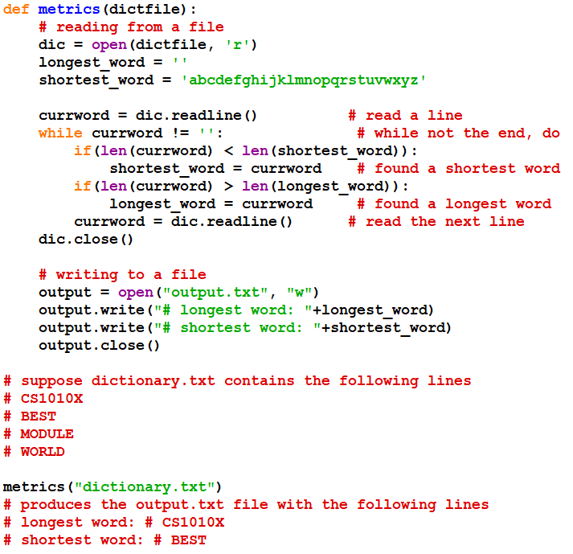
Example #1 (text file)

Slide 42
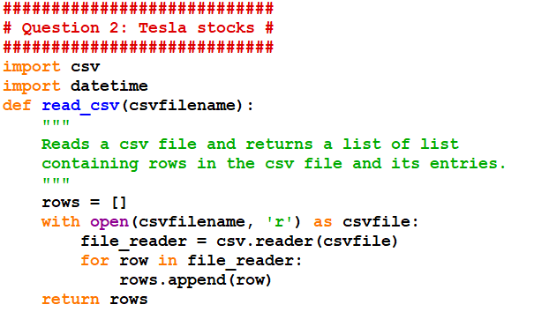
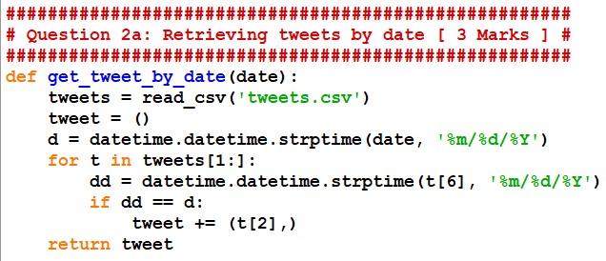
Example #2 (csv file)
CS1010X PE
June 2020, Q2
“csv” stands for
“comma-separated values”
tweets[0] is the header row
tweets[1:] are the rest of records
t is a particular row of record
t[6] is the date of the tweet
t[2] is the tweet
>>> get_tweet_by_date('12/21/2019')
>>> get_tweet_by_date('5/1/2020')

